Slide 1
Elements of Dance
Lesson 3

Slide 2
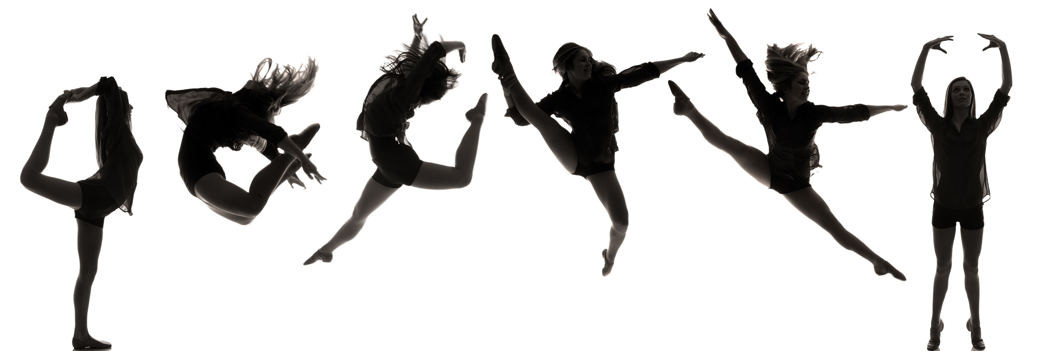
Elements- Space
Movement of the body from point A to point B

Slide 3
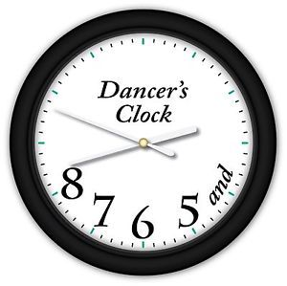
Time
The relationship of one movements or part of a movement to another.
Includes: pulse, speed/tempo, duration, rhythm, and phrases

Slide 4
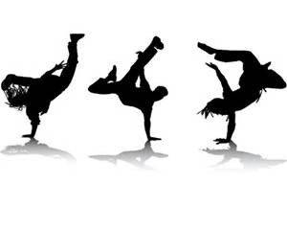
Force
Energy
Degree of muscle tension and use of energy while moving

Slide 5
Dance Forms
Theme and Variation- Contrast in the use of dance elements, repetition, etc.
Rondo- A dance structure where three or more themes and one theme is repeated. Ex. ABACAD (what would the next letter be?)
Narrative-Choreographic structure that follows a specific story line to convey specific information through dance.
Ex. Thriller

Slide 6
Vocabulary- Locomotors
Movements that travel from one location to another
Movements that travel through space
Ex. Video

Slide 7
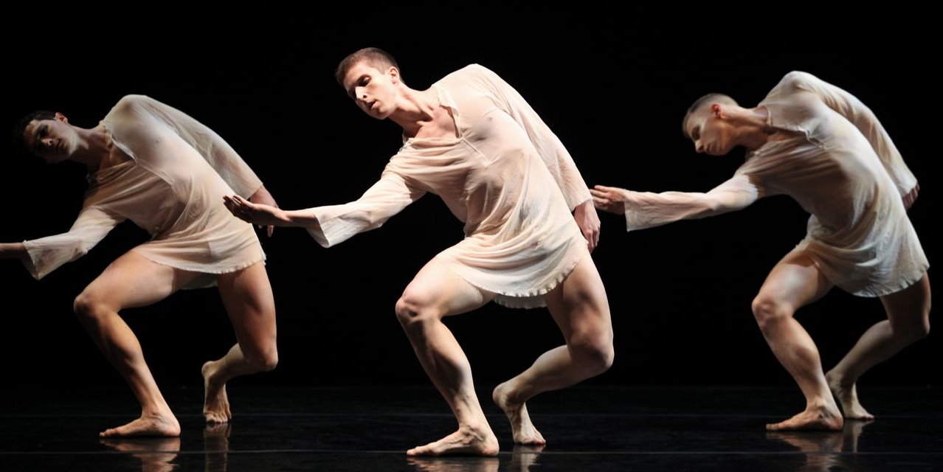
Non-locomotors
Movement that is performed around the axis of the body rather than designed for travel from place to place; movements in which a person stays in one place.
Ex: bend, push, pull, rise, sink, shake, stretch, swing, sway, etc.

Slide 8
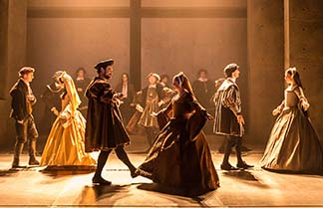
Court dances
A dignified dance for performance at a court

Slide 9
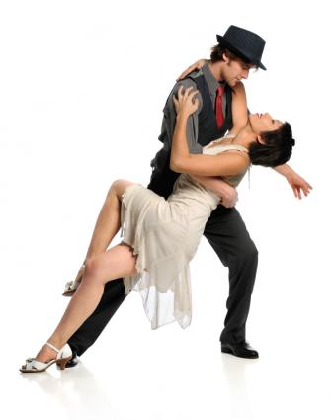
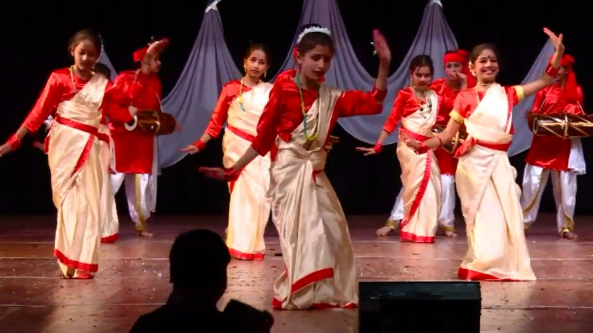
Folk and Social Dances
Dances done in a recreational or social context
Often partner dances

Slide 10
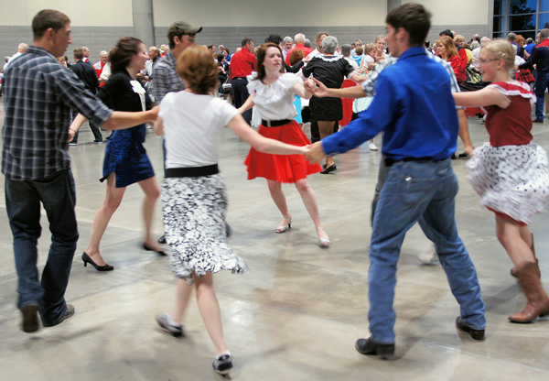
Square Dance
A dance where four couples dance together
Each couple is at a side of a square facing inwards

Slide 11
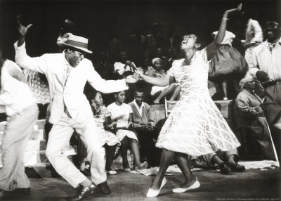
Swing Dance
A blend of several African American dances, which include Lindy hop and other dances that accompany ragtime, jazz and blues, as well as other dance music of the 20th century

Slide 12
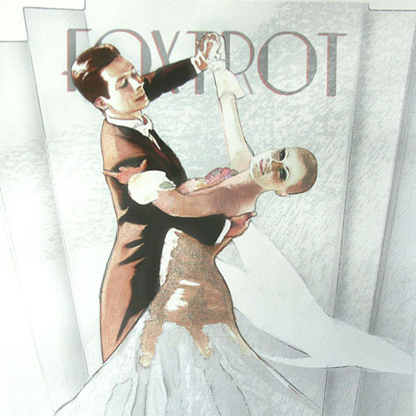
Foxtrot
A ballroom dance in 4/4 time
encompassing a variety of slow
and fast steps

Slide 13
Dance Styles- Ballet
A classic form of dance growing out of the French nobility

Slide 14
Tap
A percussive dance form in which dancers produce sound by wearing shoes to which metal taps have been added.
Concentrates on footwork and rhythm
American art form that has roots in Irish, African, and English clogging traditions
Ex. Riverdance

Slide 15
Jazz
Any of several forms of improvised rhythmic dancing to jazz music

Slide 16
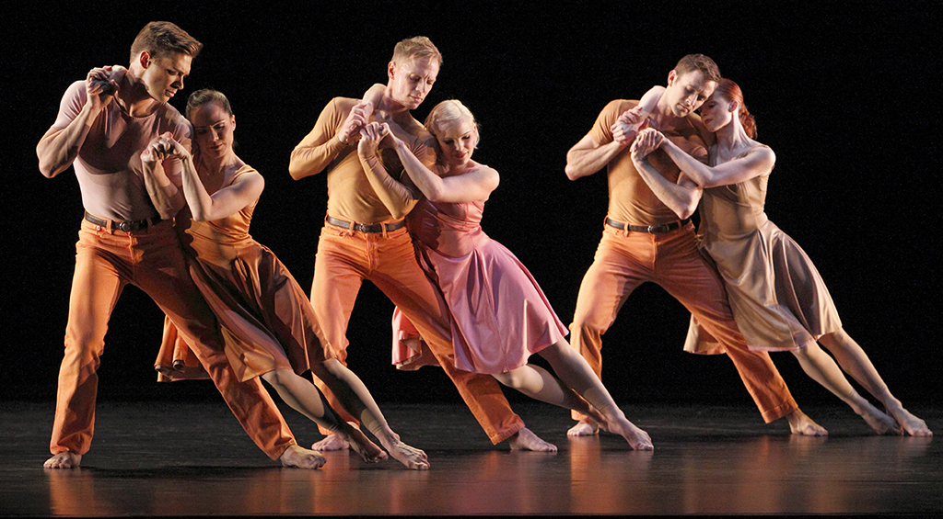
Modern
A form of dance developed by dancers interested in breaking from ballet traditions and expressing a more liberating form of movement.
Expresses complex emotions and abstract ideas.

Slide 17
Dance Purposes
Ceremonial- of or relating to, or forming a ceremonial or rite
Recreational- refreshing to the mind or body, a dance done for enjoyment.
Artistic-A dance created as a work of art. Usually performed in front of an audience and intended to express the choreographer’s ideas, images, feelings, or to evoke a response.

Slide 18
Written Response Activity
Watch the videos and write down any elements or vocabulary that you see used.
Video 1
Video 2

