Slide 1
Musical Elements
Lesson 2

Slide 2
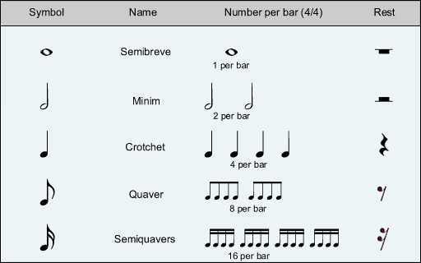
Rhythm
The organization of sound in time
Repeated sounds that create a feeling of movement
Involves meter, beat, & tempo

Slide 3
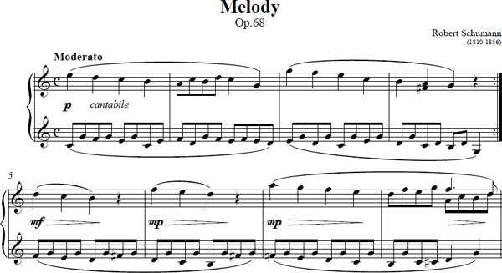
Melody
A progression of single notes
Usually the part that you remember of a song

Slide 4
Form
The organization of musical elements in time
Repetition, contrast, and variation, help to create a sense of unity.

Slide 5
Form There are 6 types of Form:
Rondo- Compostional form featuring a main theme (A) which returns several times within other themes
Ex: ABACA
Theme and Variation- The theme is repeated over and over and is changed each time in melody, rhythm, and harmony, dynamics, and tone color.
Ex: symphony no. 94 in g major
Overture- Short musical composition, purely orchestral, which opens an opera. It sets the overall dramatic mood.
Ex: Hector Berlioz: Roman Carnival Overture
Aria- Song for solo voice with orchestral accompaniment. Found in operas, oratorios, and cantatas
Recitative-Vocal line in an opera, oratorio, or cantata that imitates rhythm and pitch fluctuations.
Classical Symphony-orchestral composition written in four movements, typicaly lasting between 20-45 minutes.
Ex: Beetovan: Symphony no. 9

Slide 6
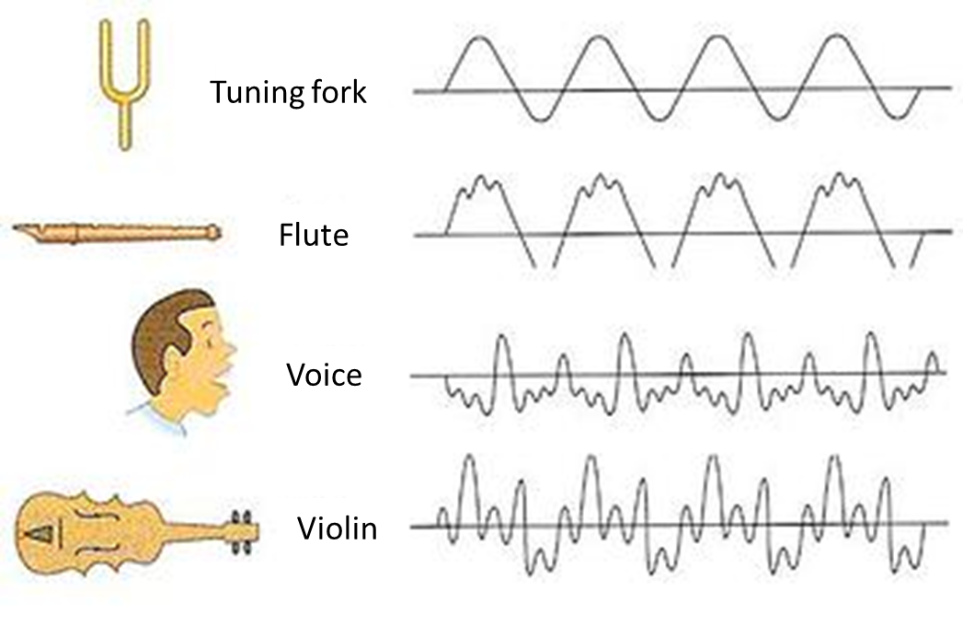
Timbre
Quality of sound that distinguishes one instrument or voice from another.
Tone color
Ex: Louis Armstrong
Ex: Nickel Creek

Slide 7
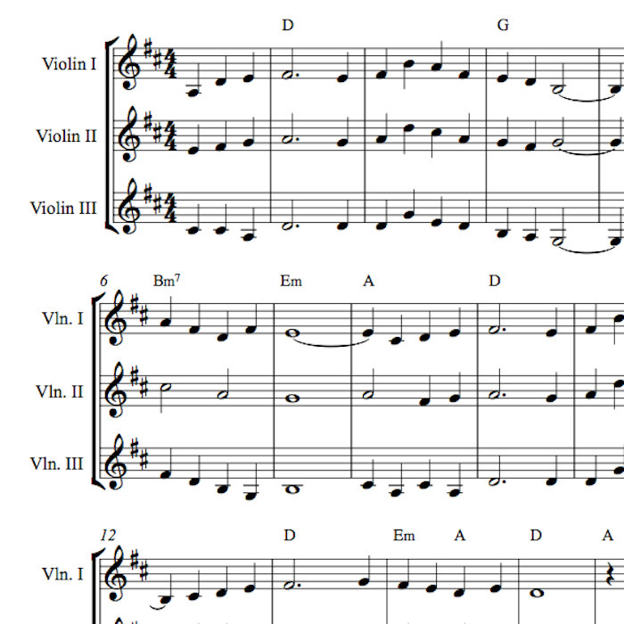
Harmony
Two or more tones sounding together
Simultaneous combination of sounds
A chord
Ex: Pentatonix

Slide 8
Tempo
The speed of the beat in music
Allegro- A rapid, vivacious movement
Andante- An easily flowing movement in
moderate time, walking speed

Slide 9
Dynamics
Degree of loudness and softness
Each level is denoted a certain way:
“p” for piano- soft
“f” for forte-loud
“mp” for mezzo piano- medium soft
“mf” for mezzo forte- medium fast
“ff” for fortissimo- very loud
“pp” for pianoismo- very quiet
Ex: Usher's Yeah
Dynamic Notation:
Crecsendo- Gradual increase in volume
Decresendo- Gradual decrease in volume

Slide 10
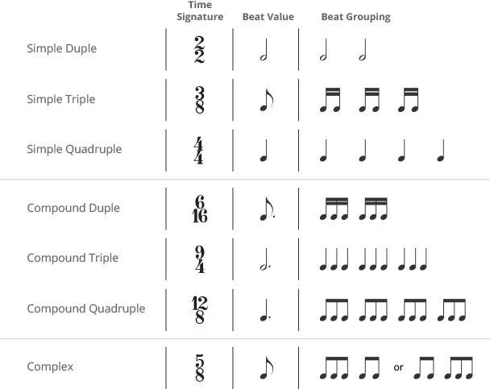
Meter
The order of the beats
Indicated by a signature at the
beginning of the work
¾ time or 4/4 time for example

Slide 11
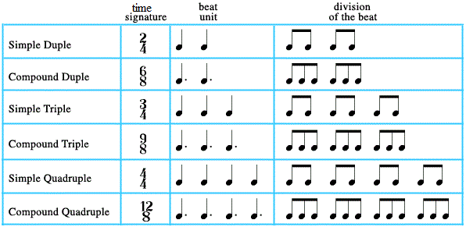
Beat
Individual pulses in music
Ex. The Postal Service- District Sleeps Alone Tonight

Slide 12
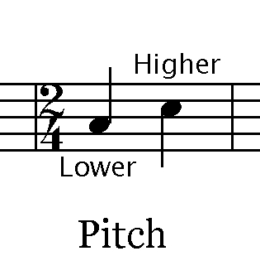
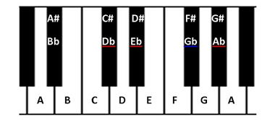
Pitch
Highness and Lowness of a tone
Tone- A musical sound of a specific pitch (how an instrument sounds)

Slide 13
Purposes of Music
Ceremonial- music created or performed for rituals or celebrations
Recreational- music for entertainment
Artistic Expression- music created with the intent to express or communicate one’s emotions, feelings, or experience

Slide 14
Response Activity
Compare and contrast these two videos:
Beautiful Girls
Stand By Me

Slide 15
Homework: Write your own song that includes-
one verse followed by a chorus
another verse
Repeat the same chorus
Watch for inspiration-
Process for Writing Songs- Ed Sheeren
Drake
Jay Z

Slide 16
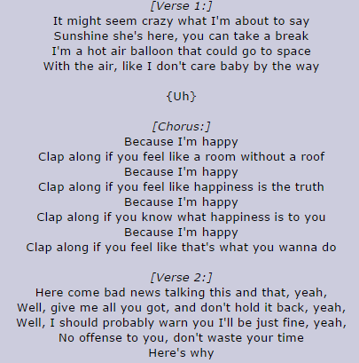
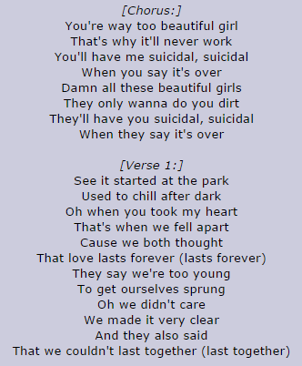
Write Your Own Song
2 verses
1 chorus

Slide 17
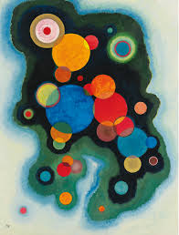
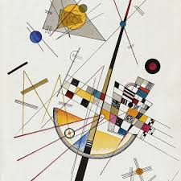
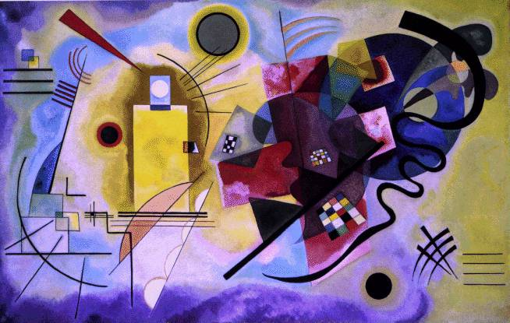
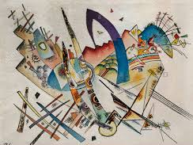
Art Activity:
Listen to music and paint what you feel as you listen much like Wasilly Kandinsky’s work.
https://www.youtube.com/watch?v=MVzUfiVlfr0

